Slide 1
Computer programming

Slide 2
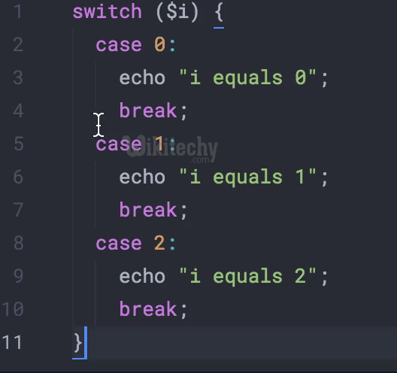
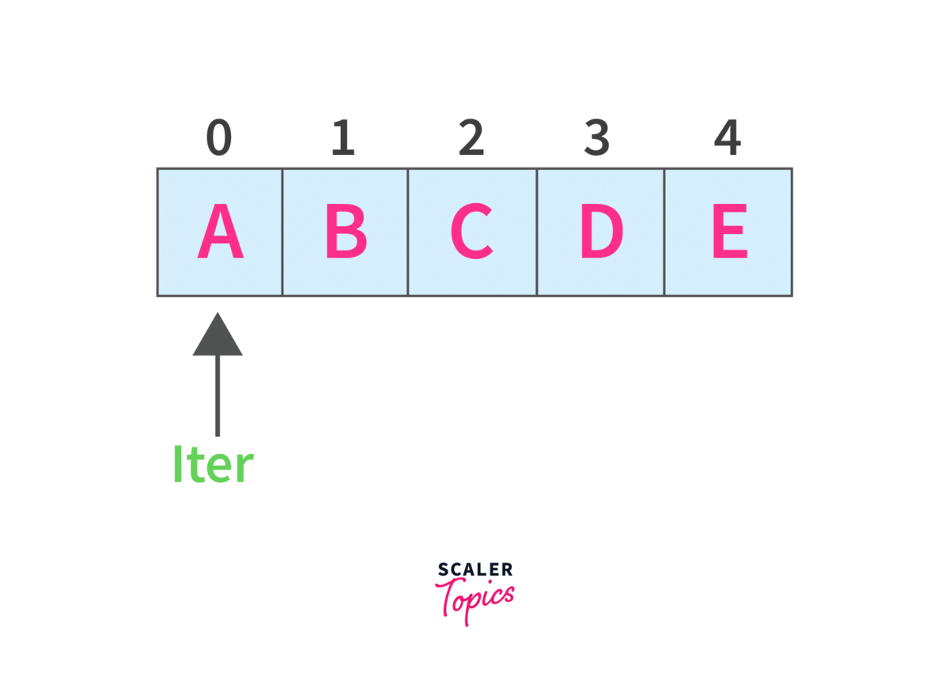
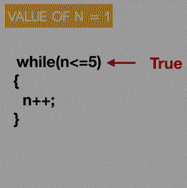
Let’s have some recap!
DIRECTION: Reveal the word by analyzing the given set of pictures and letters. And mean.
CLUE: KINDS OF MATERIALS INSERTING IN MICROSOFT WORD
B_ E_K
A _ _ _Y_
C _ _TI _ UE
BREAK
ARRAYS
CONTINUE

Slide 3


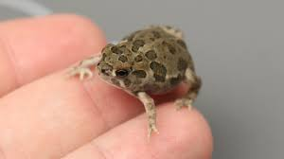




GEARBEARRISH WORDS!

Slide 4
Pre-test!
Direction: Fill in the blanks. Write your answer on the board.
________ 1. Is the name of the method.
________ 2. means that the method belongs to the Main class and not an object of the Main class.
________ 3. means that this method does not have a return value.
________ 4. specified after the method name, inside the parentheses.
________ 5. multiple methods can have the same name with different parameters:

Slide 5
Objectives
Definition of methods.
Understand the arguments of parameter.
Declaring(creates)of overloading method in different parameter?.

Slide 6
Methods in java

Slide 7
what is methods in java?
A method is a block of code which only runs when it is called.
You can pass data, known as parameters, into a method.
Methods are used to perform certain actions, and they are also known as functions.

Slide 8
WHY WE CAN USE METHODS?
To reuse code: define the code once, and use it many times.

Slide 9
Create a Method
A method must be declared within a class. It is defined with the name of the method, followed by parentheses (). Java provides some pre-defined methods, such as System.out.println(), but you can also create your own methods to perform certain actions:
Example
Create a method inside Main:
public class Main {
static void myMethod() {
// code to be executed
}
}

Slide 10
Example Explained
myMethod() is the name of the method
static means that the method belongs to the Main class and not an object of the Main class.
void means that this method does not have a return value.

Slide 11
Call a Method
To write the method's name followed by two parentheses () and a semicolon;
myMethod() is used to print a text (the action), when it is called:
Example
Inside main, call the myMethod() method:
public class Main {
static void myMethod() {
System.out.println("I just got executed!");
}
public static void main(String[] args) {
myMethod();
}
}

Slide 12
public class Main {
static void myMethod() {
System.out.println("I just got executed!");
}
public static void main(String[] args) {
myMethod();
}
}
RESULT
I just got executed!

Slide 13
A method can also be called multiple times:
Example
public class Main {
static void myMethod() {
System.out.println("I just got executed!");
}
public static void main(String[] args) {
myMethod();
myMethod();
myMethod();
}
}

Slide 14
public class Main {
static void myMethod() {
System.out.println("I just got executed!");
}
public static void main(String[] args) {
myMethod();
myMethod();
myMethod();
}
}
RESULT
I just got executed!
I just got executed!
I just got executed!

Slide 15
Parameters and Arguments
Information can be passed to methods as parameter. Parameters act as variables inside the method.
Parameters are specified after the method name, inside the parentheses. You can add as many parameters as you want, just separate them with a comma.
For example has a method that takes a String called fname as parameter. When the method is called, we pass along a first name, which is used inside the method to print the full name:

Slide 16
Example
public class Main {
static void myMethod(String fname) {
System.out.println(fname + " Refsnes");
}
public static void main(String[] args) {
myMethod("Liam");
myMethod("Jenny");
myMethod("Anja");
}
}

Slide 17
public class Main {
static void myMethod(String fname) {
System.out.println(fname + " Refsnes");
}
public static void main(String[] args) {
myMethod("Liam");
myMethod("Jenny");
myMethod("Anja");
}
}
OUTPUT
Liam Refsnes
Jenny Refsnes
Anja Refsnes
When a parameter is passed to the method, it is called an argument. So, from the example above: fname is a parameter, while Liam, Jenny and Anja are arguments.

Slide 18
Multiple Parameters
You can have as many parameters as you like
Example
public class Main {
static void myMethod(String fname, int age) {
System.out.println(fname + " is " + age);
}
public static void main(String[] args) {
myMethod("Liam", 5);
myMethod("Jenny", 8);
myMethod("Anja", 31);
}
}

Slide 19
public class Main {
static void myMethod(String fname, int age) {
System.out.println(fname + " is " + age);
}
public static void main(String[] args) {
myMethod("Liam", 5);
myMethod("Jenny", 8);
myMethod("Anja", 31);
}
}
OUTPUT
Liam is 5
Jenny is 8
Anja is 31
Note: that when you are working with multiple parameters, the method call must have the same number of arguments as there are parameters, and the arguments must be passed in the same order.

Slide 20
Return Values
The void keyword, used in the examples above, indicates that the method should not return a value. If you want the method to return a value, you can use a primitive data type (such as int, char, etc.) instead of void, and use the return keyword inside the method:
Example
public class Main {
static int myMethod(int x) {
return 5 + x;
}
public static void main(String[] args) {
System.out.println(myMethod(3));
}
}

Slide 21
public class Main {
static int myMethod(int x) {
return 5 + x;
}
public static void main(String[] args) {
System.out.println(myMethod(3));
}
}
OUTPUT
//8 ( 5 + 3 )
This example returns the sum of a method's two parameters:

Slide 22
Example
public class Main {
static int myMethod(int x, int y) {
return x + y;
}
public static void main(String[] args) {
System.out.println(myMethod(5, 3));
}
}
// Outputs 8 (5 + 3)
You can also store the result in a variable (recommended, as it is easier to read and maintain):

Slide 23
Overloading
Method overloading, multiple methods can have the same name with different parameters:
Example
int myMethod(int x)
float myMethod(float x)
double myMethod(double x, double y)
Consider the following example, which has two methods that add numbers of different type:

Slide 24
Example
static int plusMethodInt(int x, int y) {
return x + y;
}
static double plusMethodDouble(double x, double y) {
return x + y;
}
public static void main(String[] args) {
int myNum1 = plusMethodInt(8, 5);
double myNum2 = plusMethodDouble(4.3, 6.26);
System.out.println("int: " + myNum1);
System.out.println("double: " + myNum2);
}

Slide 25
public class Main {
static int plusMethodInt(int x, int y) {
return x + y;
}
static double plusMethodDouble(double x, double y) {
return x + y;
}
public static void main(String[] args) {
int myNum1 = plusMethodInt(8, 5);
double myNum2 = plusMethodDouble(4.3, 6.26);
System.out.println("int: " + myNum1);
System.out.println("double: " + myNum2);
}
}
OUTPUT
int: 13
double: 10.559999999999999
Instead of defining two methods that should do the same thing, it is better to overload one.

Slide 26

Assessment

Slide 27
Exercise:
Insert the missing part to call myMethod from main two times.
static void myMethod() {
System.out.println("I just got executed!");
}
public static void main(String[] args) {
_________;
_________;
}

Slide 28
Exercise:
Add a fname parameter of type String to myMethod, and output "John Doe".
static void myMethod(____ ____) {
System.out.println(___+ " Doe");
}
public static void main(String[] args) {
myMethod("John");
}

Slide 29
Exercise:
Follow the comments to insert the missing parts of the code below:
// Create a checkAge() method with an integer variable called age
static void
____(___ ____) {
// If age is less than 18, print "Access denied"
___ (___ ___ ____){
System.out.println("Access denied");
// If age is greater than, or equal to, 18, print "Access granted"
} ___{
System.out.println("Access granted");
}
}
public static void main(String[] args) {
// Call the checkAge method and pass along an age of 20
___ (___);
}

Slide 30


Slide 31
Exercise:
Insert the missing part to call myMethod from main two times.
static void myMethod() {
System.out.println("I just got executed!");
}
public static void main(String[] args) {
myMethod();
myMethod();
}

Slide 32
Exercise:
Add a fname parameter of type String to myMethod, and output "John Doe".
static void myMethod( String fname) {
System.out.println( fname + " Doe");
}
public static void main(String[] args) {
myMethod("John");
}

Slide 33
Exercise:
Follow the comments to insert the missing parts of the code below:
// Create a checkAge() method with an integer variable called age
static void
checkAge(int age) {
// If age is less than 18, print "Access denied"
if (age<18){
System.out.println("Access denied");
// If age is greater than, or equal to, 18, print "Access granted"
} else{
System.out.println("Access granted");
}
}
public static void main(String[] args) {
// Call the checkAge method and pass along an age of 20
checkAge(20);
}

